Slide 1
Update of California Department of Water Resources Power Purchase Contract Efforts
Prepared by
California Department of Water Resources
May 31, 2001

Slide 2
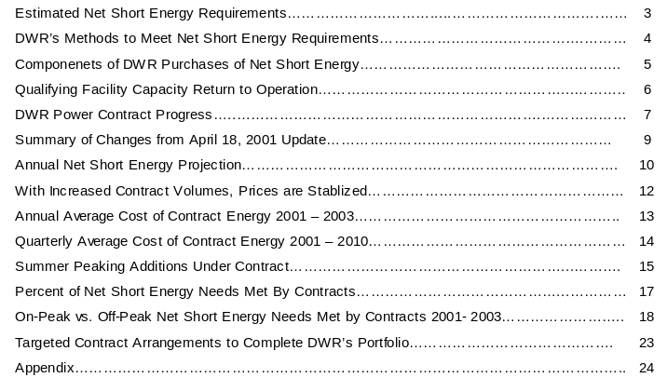
Table of Contents
Page

Slide 3
Estimated Net Short Energy Requirements
DWR is purchasing the net short energy requirements for retail electric customers (Customers) of the California investor-owned utilities (IOUs). The net short energy requirements represent the difference between the Customers’ total electricity requirements and the amount of energy provided by the IOUs’ retained generation, which includes:
  Generating resources owned by the IOUs (nuclear, hydroelectric, and some fossil-fueled generation located both in California and out of state)
  Capacity and energy from Qualifying Facilities (QFs) under contract to the three IOUs (renewable energy resources or cogeneration facilities operating under standard offer agreements with the IOUs)
  Certain existing power purchase agreements (PPA) or “bilateral” contracts held by the IOUs.
The amount of the net short energy requirements, in any given month, is dependent upon the Customers’ total electric energy requirements and the amount of energy produced by the utility retained generation.
Reduced hydroelectric generation capability in California in 2001 has also reduced the energy produced by the utility retained generation, increasing net short energy requirements for 2001 as compared to average conditions. These increases are also reflected in the projected net short energy requirements.
The net short energy requirements presented herein are based on forecasts created earlier this year and are subject to adjustment based upon actual Customer demand and any future changes in utility retained generation energy production, and changes in Customer direct access trends. Such updates will be completed before DWR issues bonds for the energy procurement program.
In the enclosed Appendix, are tables and figures of estimated total IOU Customer electric loads and energy requirements and net short energy requirements.

Slide 4
DWR’s Methods to Meet Net Short Energy Requirements
DWR’s approach to meeting the net short energy requirements, as shown conceptually on Figure 1, is multi-faceted:
First, DWR’s analysis incorporates assumed reductions provided by load management programs (Governor’s 20/20 Program, various legislatively established conservation programs, and several voluntary load curtailment programs).
Second, DWR has entered in a significant number of contracts and continues to negotiate long-term power contracts. Initial contracting activity succeeded in drastically reducing the amount of energy subject to spot market prices. Current activity is focused on achieving further reductions in the peak load aspect of the net short through dispatchable resources to follow peak load.
The “residual net short” is the amount of power needs currently remaining after accounting for DWR’s long-term contracting activities. DWR will meet these remaining power needs through the strategic balancing of a variety of options, including:
  Additional long-term contracting;
  “Short-term” contracting performed by DWR’s trading desk to take advantage of changing market conditions (e.g. contracts for Quarterly, Monthly, Balance-of-Month, Day-Ahead, Hour-Ahead); and
  Real-time supply through the ISO.

Slide 5
Components of DWR Purchases of Net Short Energy
Figure 1
Load Management Programs
Contracts
Surplus
Net Short
Residual Net Short
Additional Contracts
Quarterly Contracts
Monthly Desk Purchases
Balance of Month Desk Purchases
Day Ahead
- On Peak
-Off Peak
Hour Ahead
Real Time Balancing Purchases

Slide 6
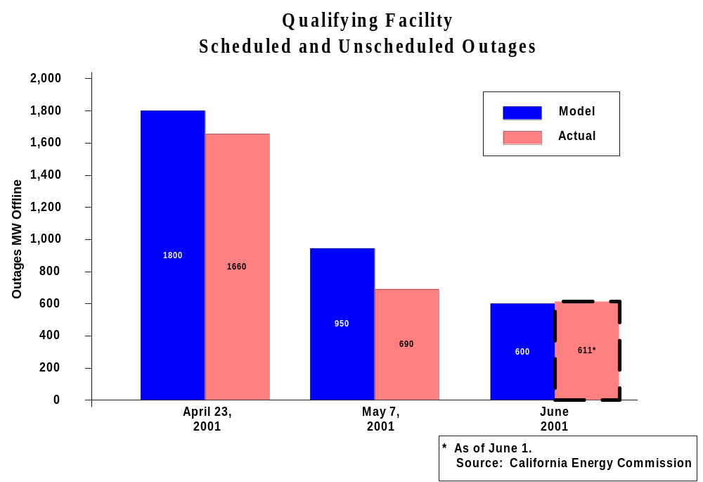
Qualifying Facility Capacity Return to Operation
In prior projections, QF capacity was estimated to be reduced by 1,800 MW in April 2001, 950 MW in May, and approximately 550 MW in June 2001, with similar reductions to the June level thereafter.
As shown in Figure 2, the QF capacity has returned to levels better than these projections, as of the first week of May.
Figure 2

Slide 7
DWR Power Contract Progress
Figure 3 shows the changes in contract additions since the April 18 update report provided by DWR.
Note that this depiction of the contract annual energy volumes includes energy available from dispatchable generating units. For dispatchable contracts, DWR typically pays a fixed monthly or annual capacity payment and has rights to dispatch (require operation) of the unit, typically intended for peak hours. This figure shows the amount of energy if all the available dispatchable energy was requested.

Slide 8
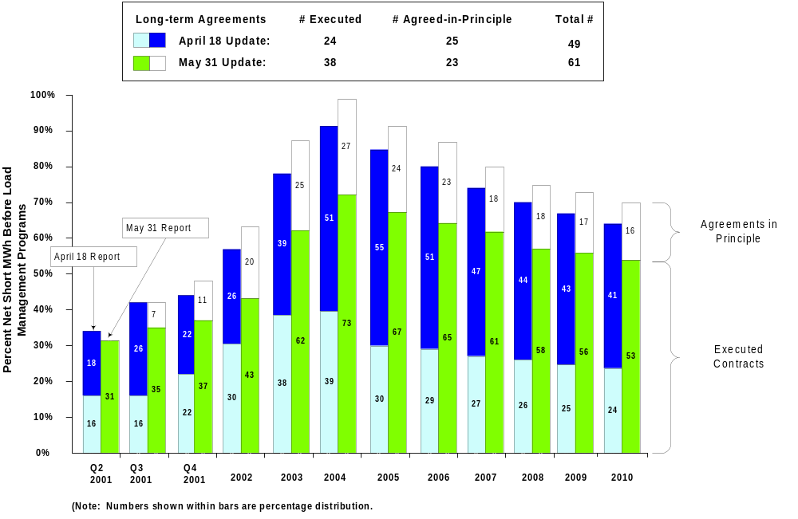
DWR Power Contract Progress (cont’d)
Figure 3

Slide 9
Summary of Changes from April 18, 2001 Update
Average annual capacity under contract for 2001-2010 increased from 9,725 MW to 10,950 MW (including Executed agreements and Agreements in Principle).
A net 14 additional agreements were Executed, providing a net additional 2,160 MW in 2001, and an annual average of 2,080 net additional MW during 2001-2010. Sources of the changes were:
  8 Agreements in Principle were converted to Executed Contracts
  5 new agreements which went directly to final Executed contracts without an intermediate Agreement in Principle
  2 PX Block Forward agreements were reclassified as Executed*
  reduction of 1 Executed agreement which had an option for a term extension which was not exercised
There was a net decrease of 2 Agreements in Principle. Sources of the changes were:
  11 new Agreements in Principle
  10 Agreements in Principle moved to the Executed category
  3 Agreements in Principle were cancelled
*While these agreements have fixed prices and power is being delivered, their final valuation is subject to dispute

Slide 10
Annual Net Short Energy Projection
Figure 4 shows the updated projected annual net short energy needs and the amount of the estimated requirements to be met by energy conservation, funded load management and the energy under contract with DWR
In the past few weeks, DWR’s trading desk has increased its activity in purchasing energy on a “balance of month”, monthly and quarterly basis. These purchases are shown as “Short Term” on Figure 4 and are reflected in the so-named shaded area during 2001. These short-term contract purchases reduce DWR’s exposure to the spot (day-ahead and intra-day purchases) market.
The Short-Term contracts are also executed contracts.

Slide 11
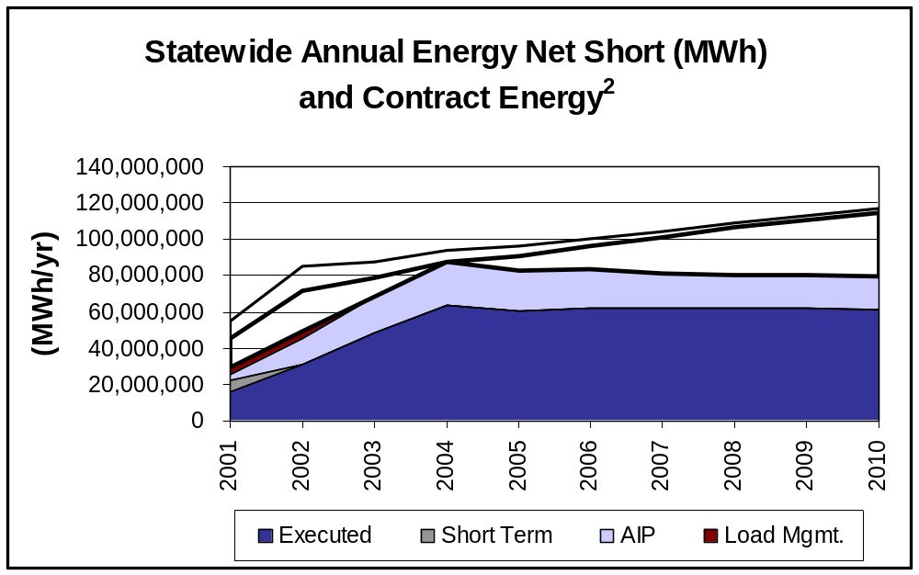
Annual Net Short Energy Requirements and Contract Energy
Figure 4
Net Short after
Conservation and Price
Elasticity Reduction
Initial Net Short¹
1. Some portion of the energy resented in this curve is dispatchable and would not be called upon for operation if the net short energy needs are less than available contract delivery quantities
2. 2001 based on May through December data.
3. “AIP” = Agreement in Principle

Slide 12
With Increased Contract Volumes, Prices are Stabilized
Figure 5 shows the average annual long-term contract costs including the increased quantities.
Figure 6 shows the quarterly average contract prices for 2001 through 2003.

Slide 13
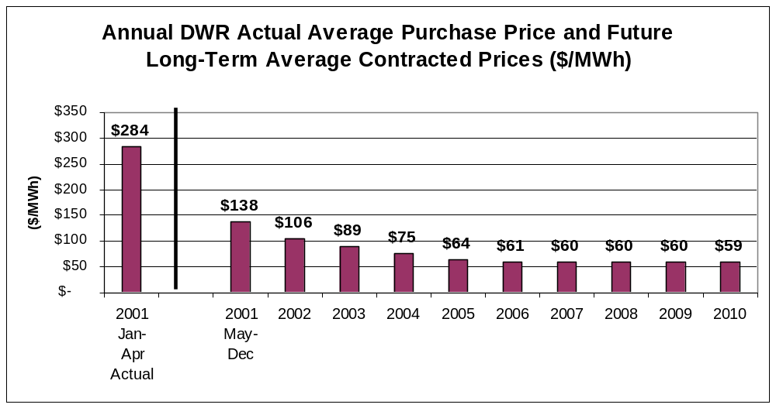
Annual Average Cost of Contract Energy 2001-2010
Figure 5
Average Contract Price across remaining 10 years (May ‘01-Dec ‘10) is $70/MWh
Average Contract Price for first 5 years (May ‘01-Dec ‘05) is $84/MWh, for last 5 years (Jan ‘06-Dec’10) is $60/MWh
Note: Estimated actuals are subject to final accounting and CAISO settlement process

Slide 14
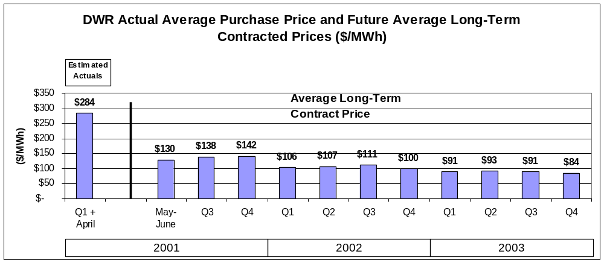
Quarterly Average Cost of Contract Energy 2001-2003
Figure 6
Note: Estimated actuals are subject to final accounting and CAISO settlement process

Slide 15
Summer Peaking Additions Under Contract
Starting in February 2001, DWR has been negotiating with parties who had “Summer Reliability Agreements” (SRA) with the California Independent System Operator (CAISO) to convert those agreements to bilateral dispatchable peaking agreements with DWR.
This conversion was undertaken because of the uncertainty of the CAISO’s ability to provide payment for the contracts due to the concerns about the creditworthiness of the IOUs, who would have been responsible for payment of the capacity under the contracts.
In addition, DWR has negotiated contracts with other Non-SRA parties for accelerated development of peaking generation for commercial operation in 2001 to increase available peaking capacity to help meet the net short energy requirements.
Figure 7 shows the monthly additions of peaking capacity from the combination of the (a) the non-SRA peaking units under contract with DWR, (b) the converted SRAs with fully executed agreements or agreements in principle, and (c) the developers who retained their SRAs with the CAISO. The SRA contract status information is summarized in more detail in the Appendix to this report.

Slide 16
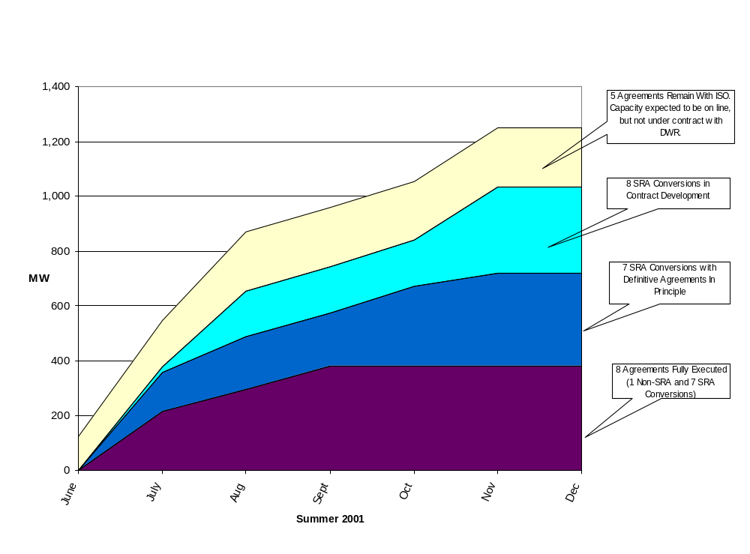
Summer Peaking Additions* Under Contract (cont’d)
Figure 7
*Includes new Summer 2001 peaking units under contract to DWR and CAISO Summer Reliability Agreement contracts, excludes other new merchant plants or other new generation which may support a portion of other DWR purchases

Slide 17
Summer Peaking Additions Under Contract (cont’d)
Fully Executed/Agreement in Principle SRA Conversions - Three (3) SRA developers, representing 14 generating units for a total of approximately 640 MW have entered into either fully executed contracts or definitive agreements in principle for the sale of capacity and associated energy to DWR. Two developers representing 7 units with a total of approximately 300 MW have fully executed agreements. Final agreements for the seven (7) SRA projects agreed to in principle are expected by early June.
Contract Development SRA Conversions - Two (2) SRA developers, representing eight (8) generating units for a total of approximately 340 MW are continuing to develop detailed contract terms for the sale of capacity and associated energy to DWR.
Remaining with CaISO SRA - Three (3) of the SRA developers, representing 5 generating units and a total of 215 MW have elected to retain their SRAs with the CaISO and are expected to be operational this year.
Fully Executed Agreements with Non-SRAs - As of the date of this report, DWR has entered into a fully executed agreement with one Non-SRA Party representing an additional summer peaking unit with a capacity of 88 MW in 2001 and 340 MW by the summer of 2002.

Slide 18
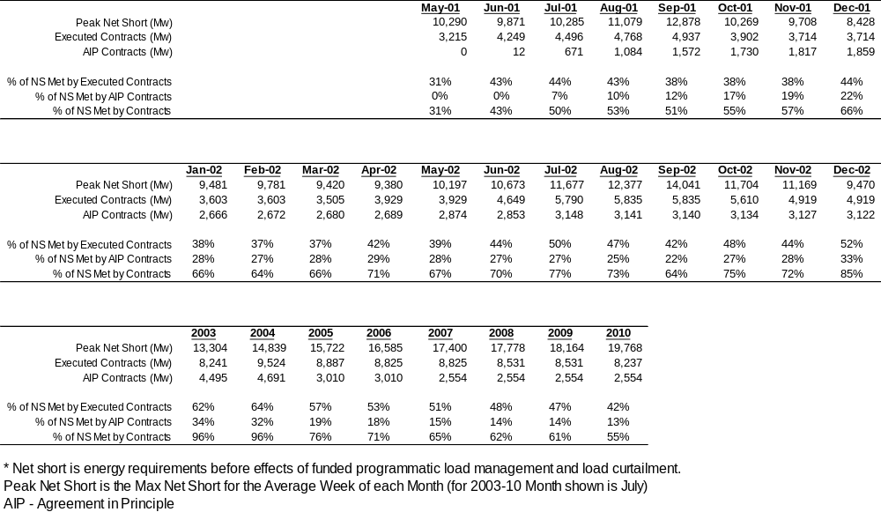
Percent of Net Short Capacity Needs Met by Contracts (MW)(After Reduction for Voluntary Conservation)
Table 1

Slide 19
On-Peak vs. Off-Peak Net Short Needs Met by Contracts
Net short met by a combination of contracts, load management and spot market purchases.
Load management programs are expected to meet a significant part of the peak hour net short energy needs for the summers of 2001 and 2002 as shown on Figures 8, 9 and 10 comparing typical months for the 2nd and 3rd quarter residual net short energy requirements on-peak and off-peak for 2001, 2002, and 2003, respectively. These figures show the long-term contract purchases. In addition, a portion of what is shown as “spot” purchases are already covered by short-term purchases DWR’s trading desk has executed.
If the load management programs do not have their projected effect, the spot market purchases for the summer of 2001 and 2002 will increase.
In Summer 2001, a significantly higher percentage of long-term contracts are for the on-peak period, reducing the amount of more costly on-peak energy that needs to be purchased in the short-term or spot market

Slide 20
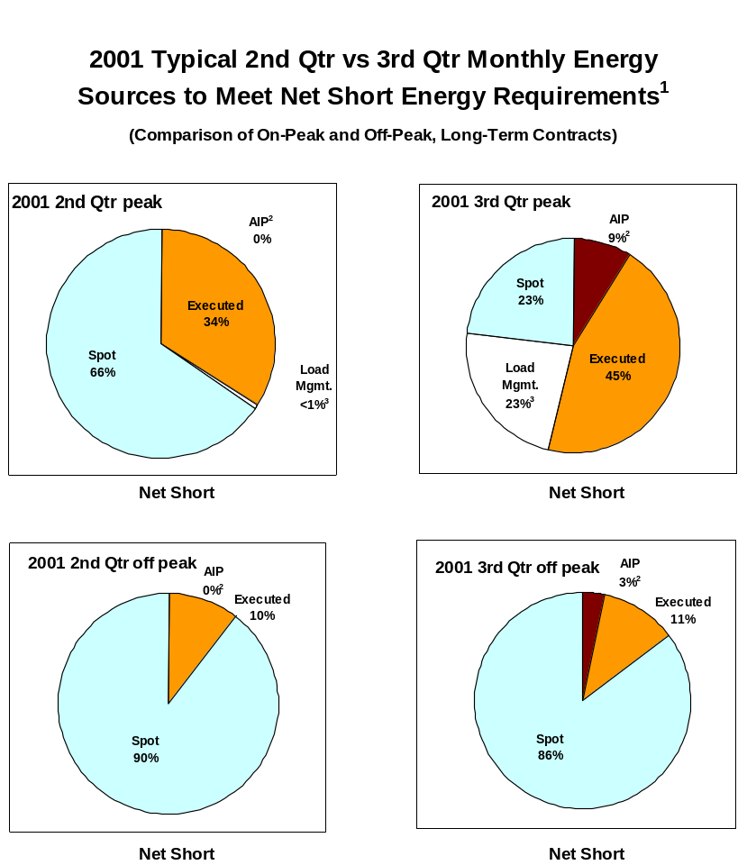
DWR has Focused its Purchases for Summer 2001 on Peak Energy Needs - Limiting Exposure to Peak Spot Prices
Figure 8
¹Values are after adjustment for voluntary conservation not included in the programmatic, funded load management programs
²Agreements in Principle
³Load management is funded conservation programs and paid load curtailment programs

Slide 21
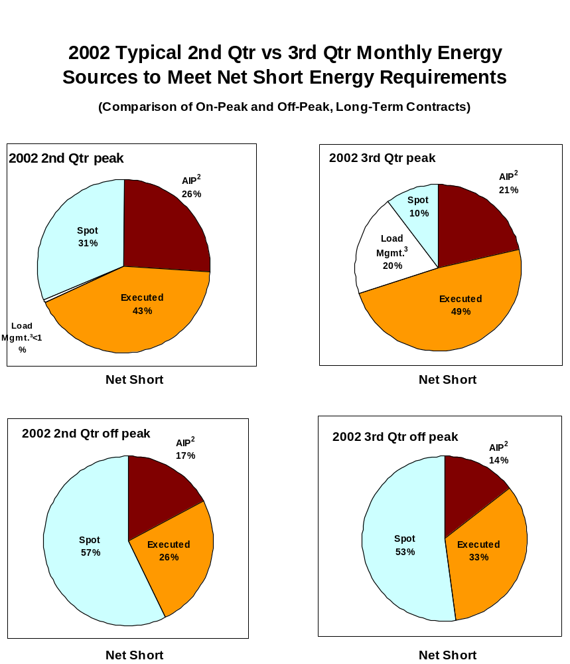
2002 Summer Peak Spot Price Exposure is Less Than 2001
Figure 9
¹Values are after adjustment for voluntary conservation not included in the programmatic, funded load management programs
²Agreements in Principle
³Load management is funded conservation programs and paid load curtailment programs

Slide 22
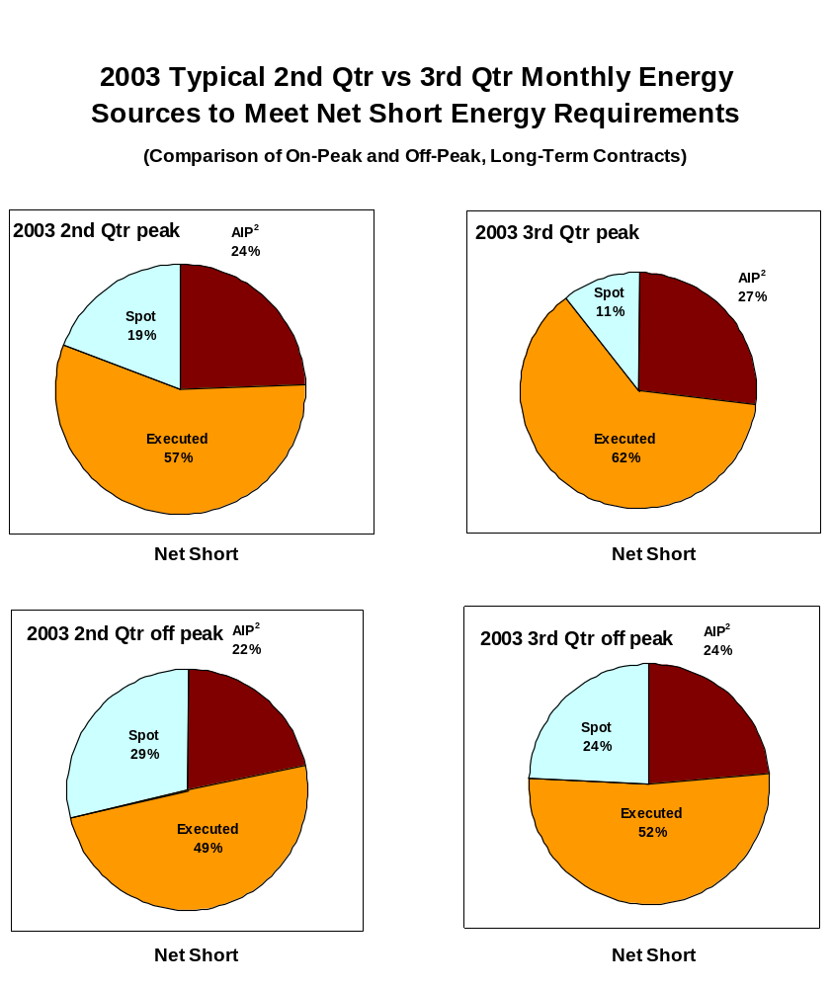
By 2003, without Load Management Programs, Spot Market Exposure is Essentially Eliminated
Figure 10
¹Values are after adjustment for voluntary conservation not included in the programmatic, funded load management programs
²Agreements in Principle

Slide 23
Targeted Contract Arrangements to Complete DWR’s Power Supply Portfolio
    Based on contracts entered into to date, absent modification of existing contracts, DWR has no need for additional 7 x 24, baseload contracts on a year-around basis after 2001, or possibly a small amount in NP-15 in 2002.
    In NP-15 (north of the Path 15 transmission constraint), DWR is still seeking some limited summer 6 X 16 (6 days a week, 16 hours per day) power resources for 2001 and 2002, with flexibility to reduce on-peak hour obligations to take energy after 2002.
    For SP-15 (south of the Path 15 transmission constraint), DWR is only seeking fully dispatchable resources, wherein DWR will purchase capacity and pay for energy on an as-scheduled basis to follow demand.
    DWR remains interested in seasonal exchanges and will consider same day or intra-month off-peak for on-peak exchanges with suppliers out of state.
    There is interest in reasonably priced new peaking generation for deliveries starting in May 2002. The extent of this need is being evaluated based upon the final disposition of converting existing agreements in principle to fully executed power supply contracts.
    In addition to the contract energy presented in tables and figures herein, DWR is in negotiation with several other parties, representing over 1,000 MW of capacity not reflected in agreements in principle. The outcome of those discussions will also effect DWR’s interest in any further contracts for 2002.

Slide 24
Appendix
May 31, 2001
Update to DWR Power Purchasing
Contract Efforts
Supporting Data

Slide 25
Estimated Net Short Energy Requirements
Table A-1 and Figure A-1 present the combined total monthly energy requirements of the Customers on an actual basis for January through April, and a projection for May through December 2001. (These figures are for total Customer requirements rather than the net short energy requirements).
The projected total energy requirements for May through December in Table A-1 and Figure A-1 is prior to any adjustment for change in energy consumption behavior by the Customers.
Table A-2 and Figure A-2 provide the same estimate for annual energy requirements 2001 through 2010.
Table A-3 and Figure A-3 show the estimated impact on energy requirements of Customer behavior due to (a) the present energy supply and general cost conditions, and (b) the expected price elasticity effects of the electric retail rate increase announced by the California Public Utilities Commission (PUC) on March 27, 2001, and proposed more specifically by rate class on May 9, 2001.
The general Customer response to the current energy situation in California is estimated to reduce Customer demand by 4% across all hours. As of June 1, when retail rates will impact Customer utility rates by an average of about 30%, an additional 3%, for a total of 7% reduction in demand in all hours is expected as reflected in Table A-3 and Figure A-3.
The above 7% reduction in demand is expected to last through 2002 and thereafter the effects are expected to decline as energy supplies increase and energy prices decline.

Slide 26
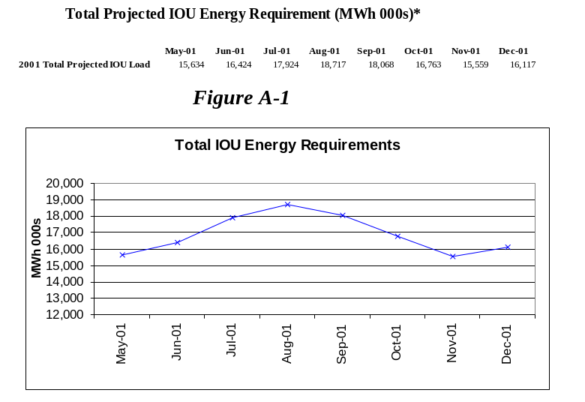
Table A-1
*Excluding observed and future expected customer usage changes due to interim energy shortage and retail rate increases, based on normal weather conditions

Slide 27
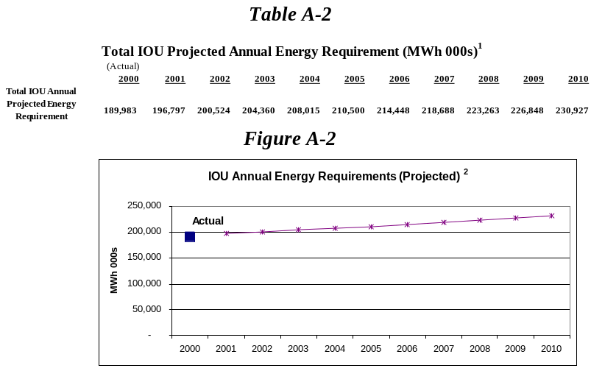
¹ Excluding observed and future expected customer usage changes due to interim energy shortage and retail rate increases, based on normal weather conditions
² Approximately 2% load growth for 2002-2010

Slide 28
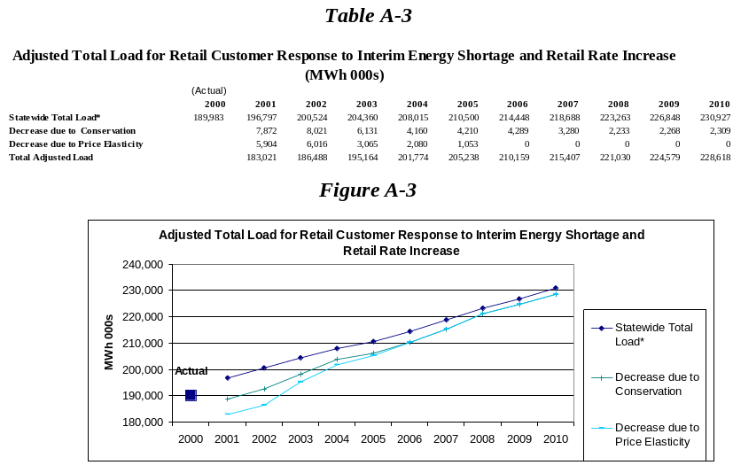
* Excluding observed and future expected customer usage changes due to interim energy shortage and retail rate increases, based on normal weather conditions

Slide 29
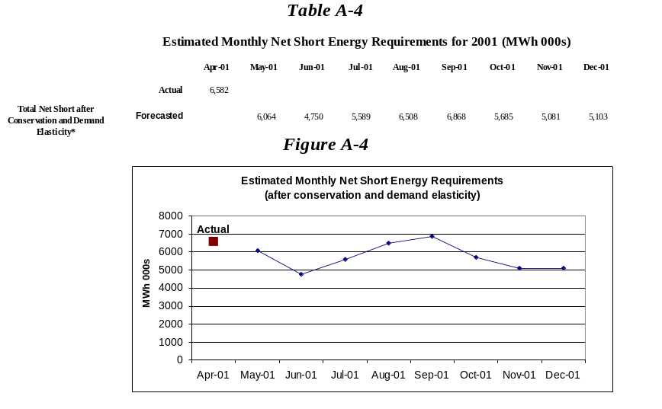
Table A-4 and Figure A-4 present the estimated monthly net short energy requirements for the Customers for 2001, after non-funded Customer conservation and estimated demand reductions after the effects of price elasticity from retail rate increases.
*Excludes effects of funded, programmatic load management and voluntary load curtailment, based on normal weather conditions

Slide 30
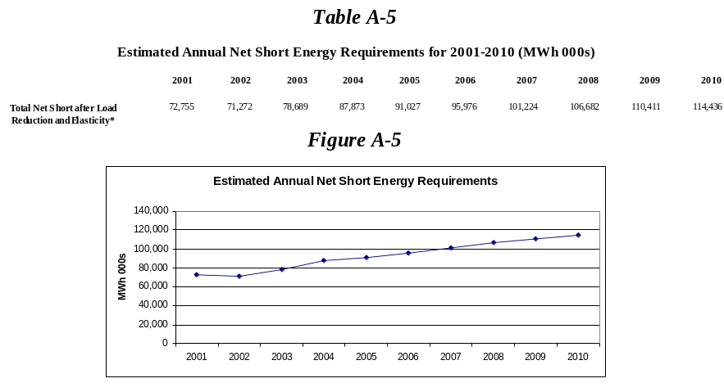
Table A-5 and Figure A-5 show similar annual estimates of the net short energy requirements for 2001 through 2010.
*Excludes effects of funded, programmatic load management and voluntary load curtailment, based on normal weather conditions

Slide 31
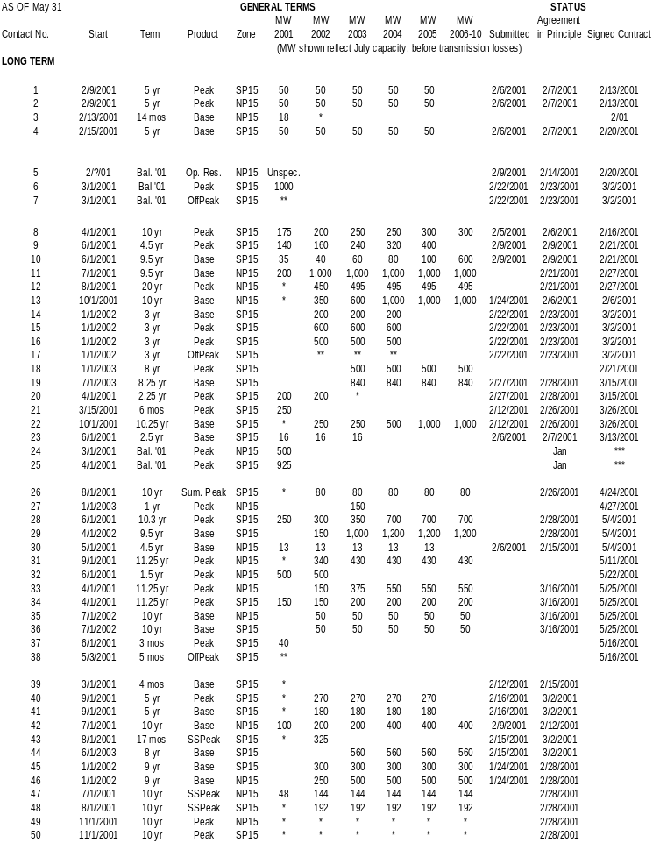
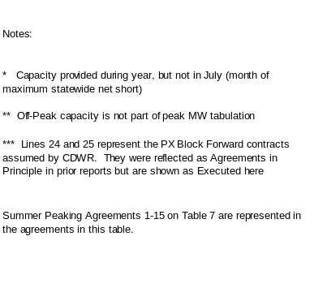
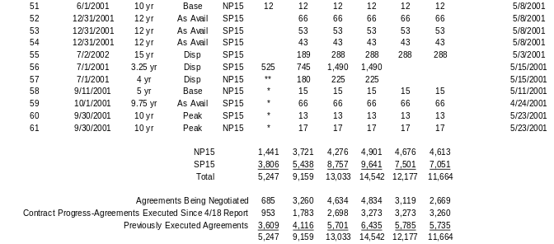
Agreements Executed and Agreed to in Principle
Table A-6

Slide 32
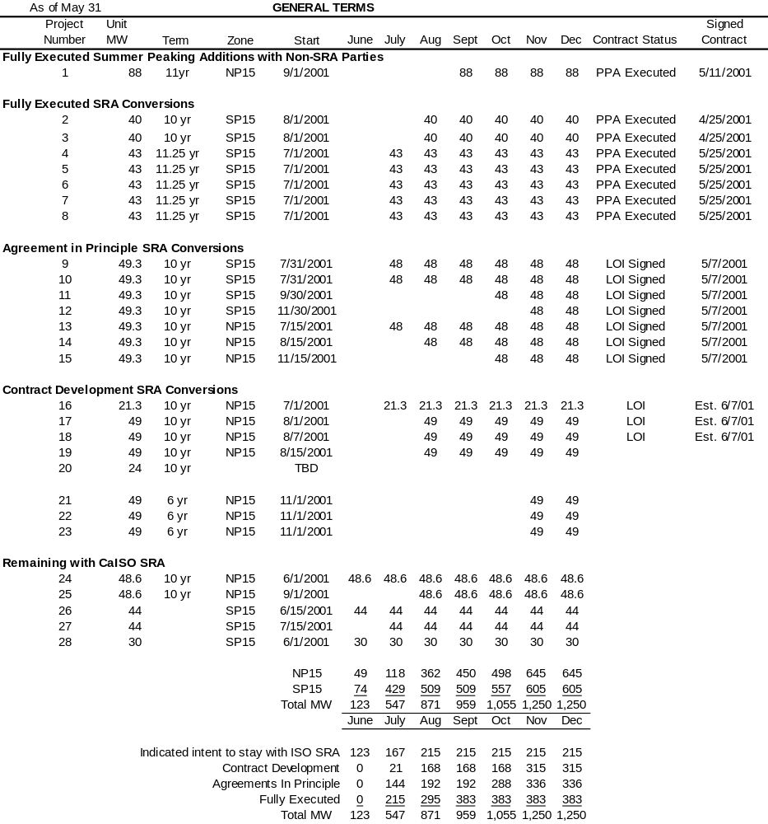
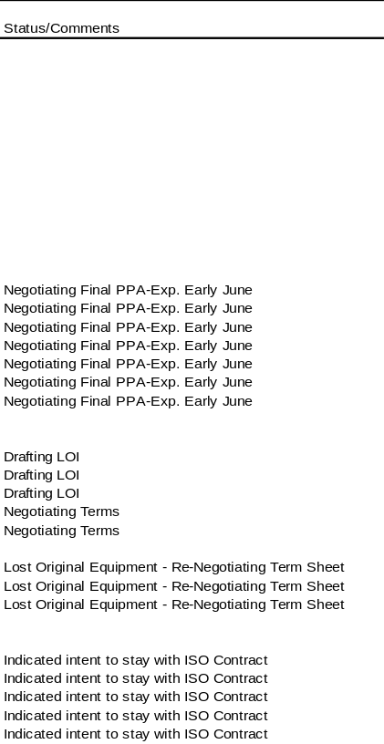
Summer Peaking Additions Under Contract
Table A-7
Note: Summer Peaking Agreements 1-15 on this table are represented in the Agreements in Table 6

Slide 33
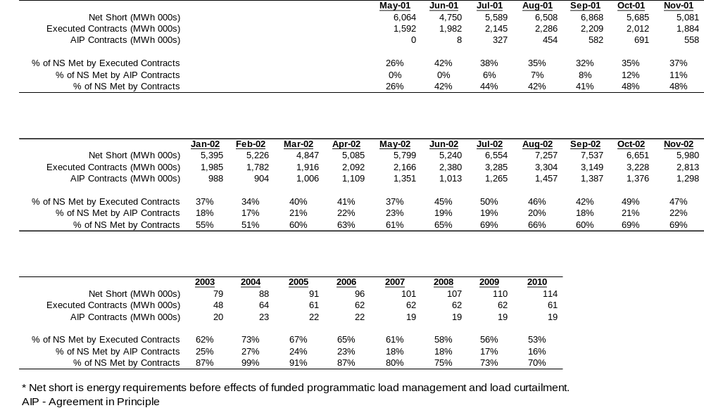
Percent of Net Short Energy Needs Met by Long-Term Contracts(MWh 000s)
Table A-8

